Slide 1
Spectral Emission from TDE Clouds around Black Holes
Lewis Shaw
Supervisor – Prof. Andy Lawrence

Slide 2
Outline
Background/Terminology
Theoretical Motivation – Coronal Line Emission
Modelling
CLOUDY
Different Models
Results
Conclusion and Next Steps
Questions

Slide 3
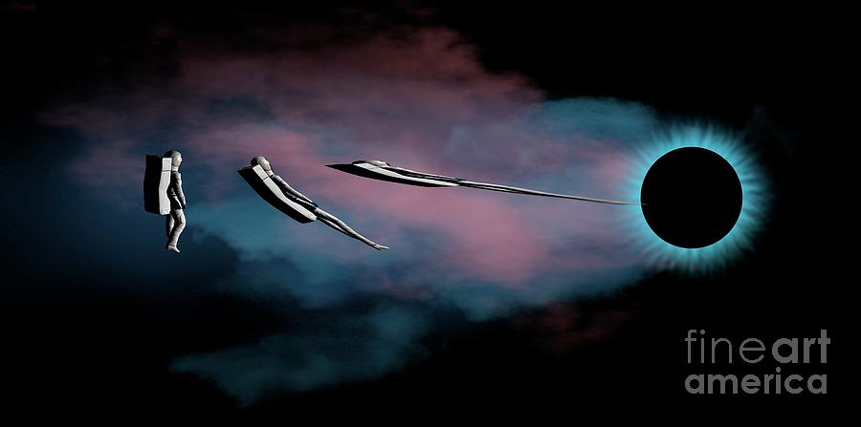
Spaghettification
Stretching and Compression in Strong, Non-Homogeneous Gravitational Field
Within small region, stretching and compression balance so no net change in volume

Slide 4
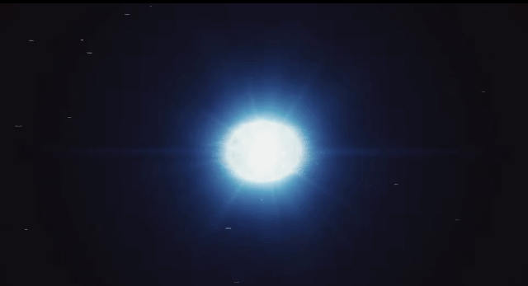
Tidal Disruption Events (TDEs)
Occur when Stellar Objects wanders too near a Supermassive Black Hole (SMBH), being ripped apart by tidal forces
→ Spaghettification
Highly Luminous
Ionizes Gas Clouds
→ Reprocessed Emission
Animated gif showing a simulation of a Tidal Disruption Event - Credit: DESY, Science Communication Lab

Slide 5
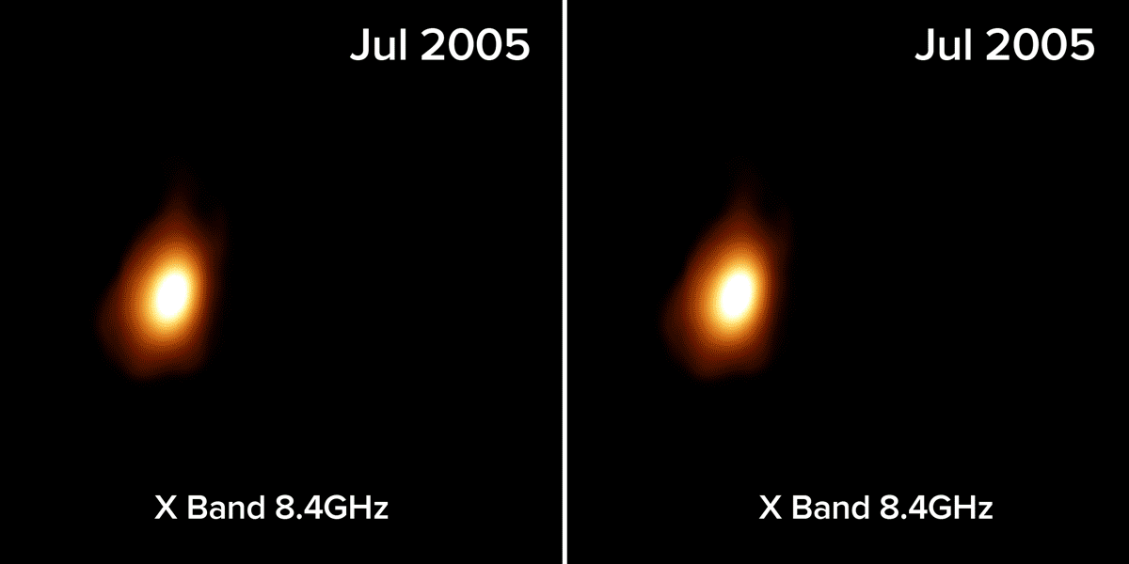
Tidal Disruption Events (TDEs)
Occur when Stellar Objects wanders too near a Supermassive Black Hole (SMBH), being ripped apart by tidal forces
→ Spaghettification
Highly Luminous
Ionizes Gas Clouds
→ Reprocessed Emission
Animated gif showing expansion of radio-emitting region where star was shredded by supermassive black hole. Expansion indicates jet of particles moving outward.
Credit: Mattila, Perez-Torres, et al.; Bill Saxton, NRAO/AUI/NSF

Slide 6
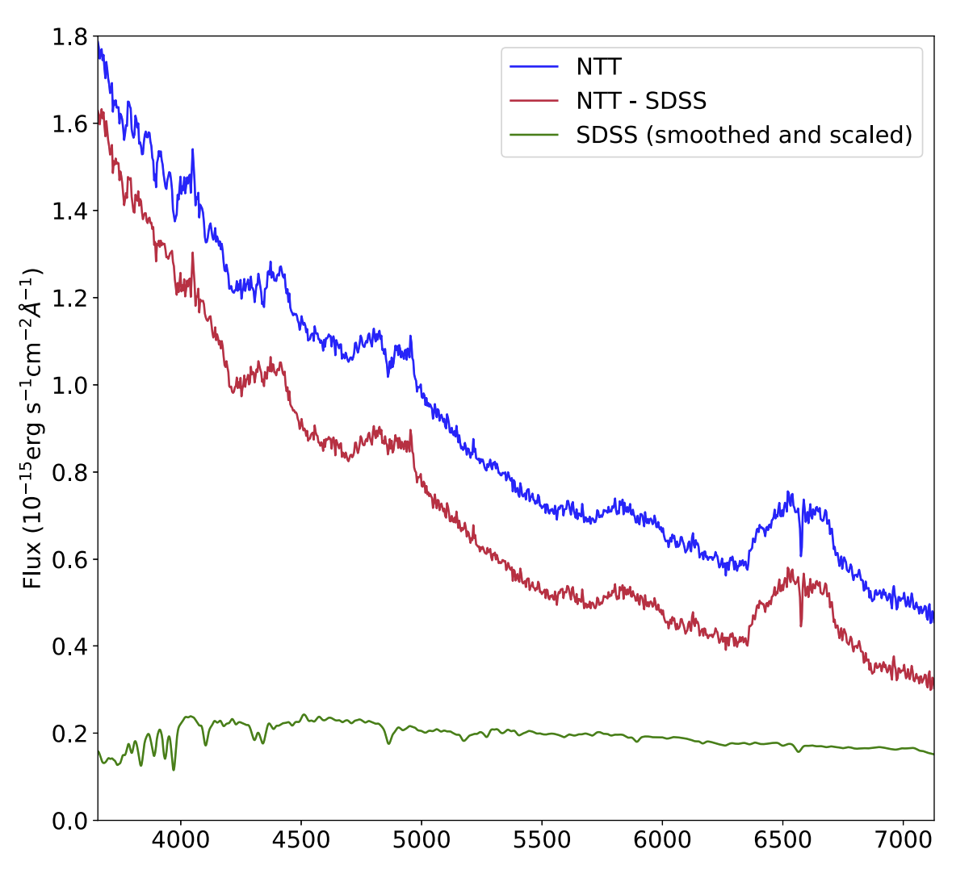
Typical Spectrum
Hα
Short, P et al. (Sept. 2020). “The tidal disruption event AT2018hyz – I. Double-peaked emission lines and a flat Balmer decrement”. In: Monthly Notices of the Royal Astronomical Society 498.3, pp. 4119–4133. issn: 0035-8711. doi: 10.1093/mnras/staa2065.
He II

Slide 7
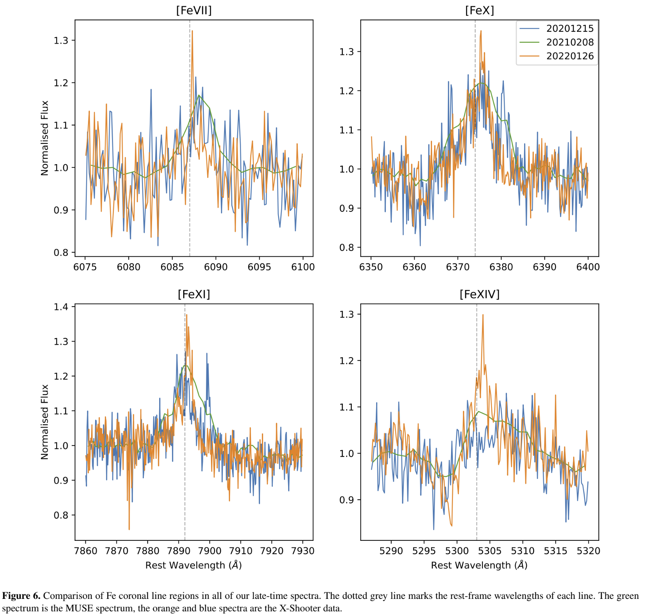
The Problem - Coronal Lines
Highly Ionized Forbidden Transitions >90eV
Delayed – 1 to 2 yrs after TDE
Short, P et al. “Delayed Appearance and Evolution of Coronal Lines in the TDE AT2019qiz” [Submitted]

Slide 8
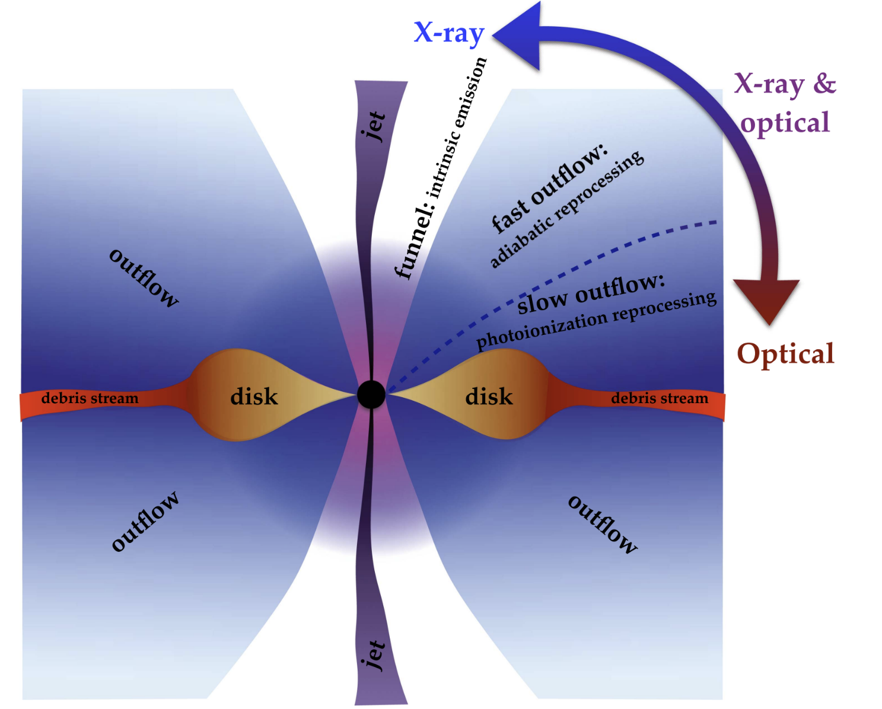
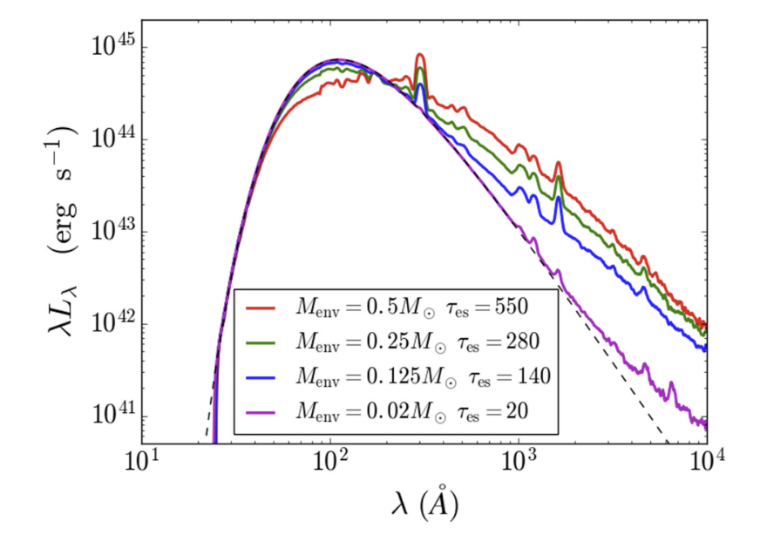
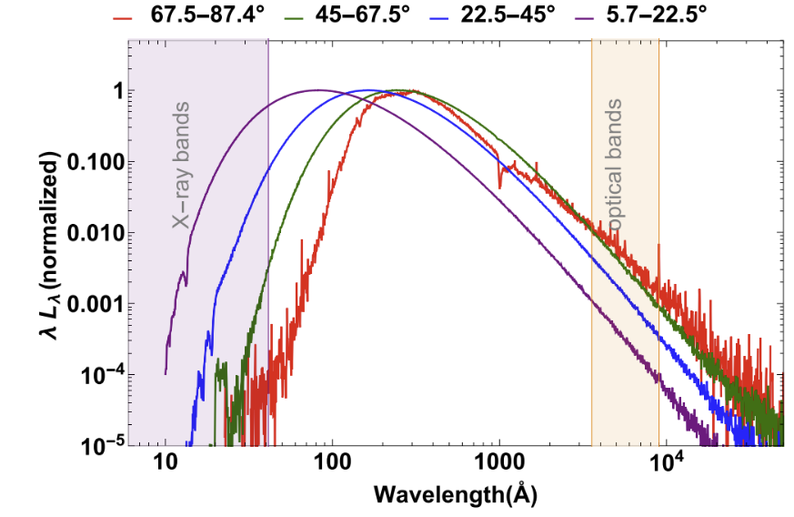
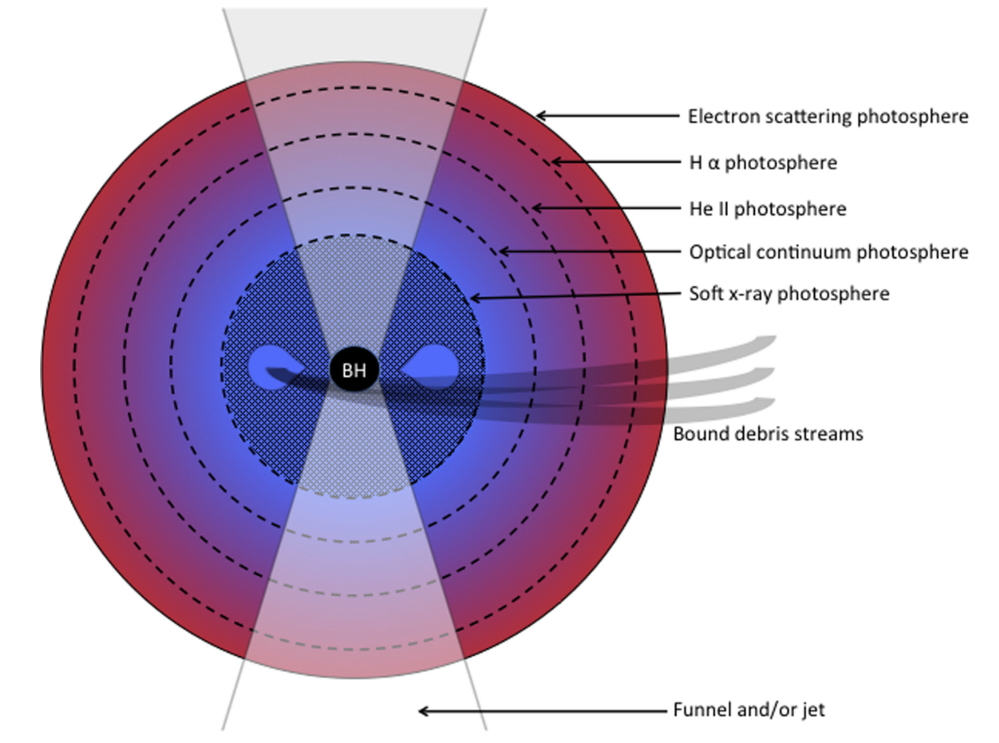
Common Models
Roth, Nathaniel et al. (Aug. 2016). “The X-Ray through Optical Fluxes and Line Strengths of Tidal Disruption Events”. In: 827.1, 3, p. 3. doi: 10.3847/0004-637X/827/1/3. arXiv:1510.08454 [astro-ph.HE]
Dai, Lixin et al. (June 2018). “A Unified Model for Tidal Disruption Events”. In: 859.2, L20, p. L20. doi: 10.3847/2041-8213/aab429. arXiv: 1803.03265 [astro-ph.HE]

Slide 9

How? - CLOUDY
Photoionization Spectral Synthesis Code written by Prof. Gary Ferland, University of Kentucky
Models spectral flux through spherical shells, computing output and input continuums for each shell and combining to get total

Slide 10

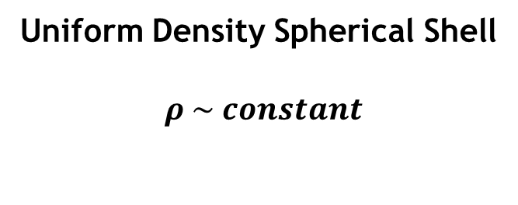
My Models
R_{inner}
Uniform Density Spherical Shell
$$ρ \sim constant$$
R_{outer}

Slide 11
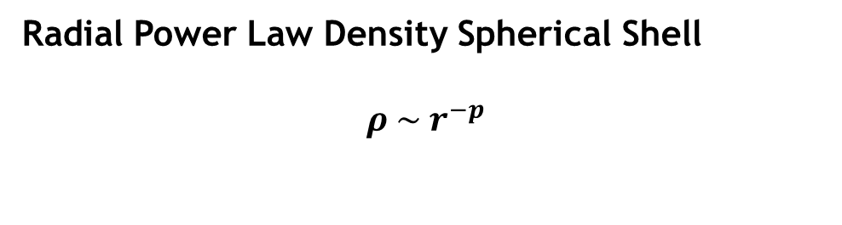
My Models
R_{inner}
Radial Power Law Density Spherical Shell
$$ρ \sim r^{−p}$$
R_{outer}

Slide 12
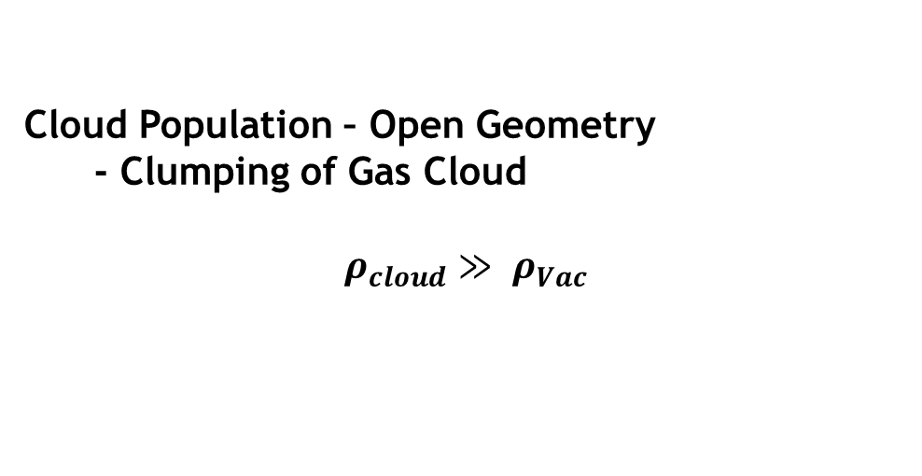
My Models
Extended Ionising Continuum
Depth Δr
Cloud Population – Open Geometry
- Clumping of Gas Cloud
$$ρ_{cloud}≫ ρ_{Vac}$$
R

Slide 13
Results
Lewis Shaw – Spectral Emission from TDE Clouds Around Black Holes

Slide 14
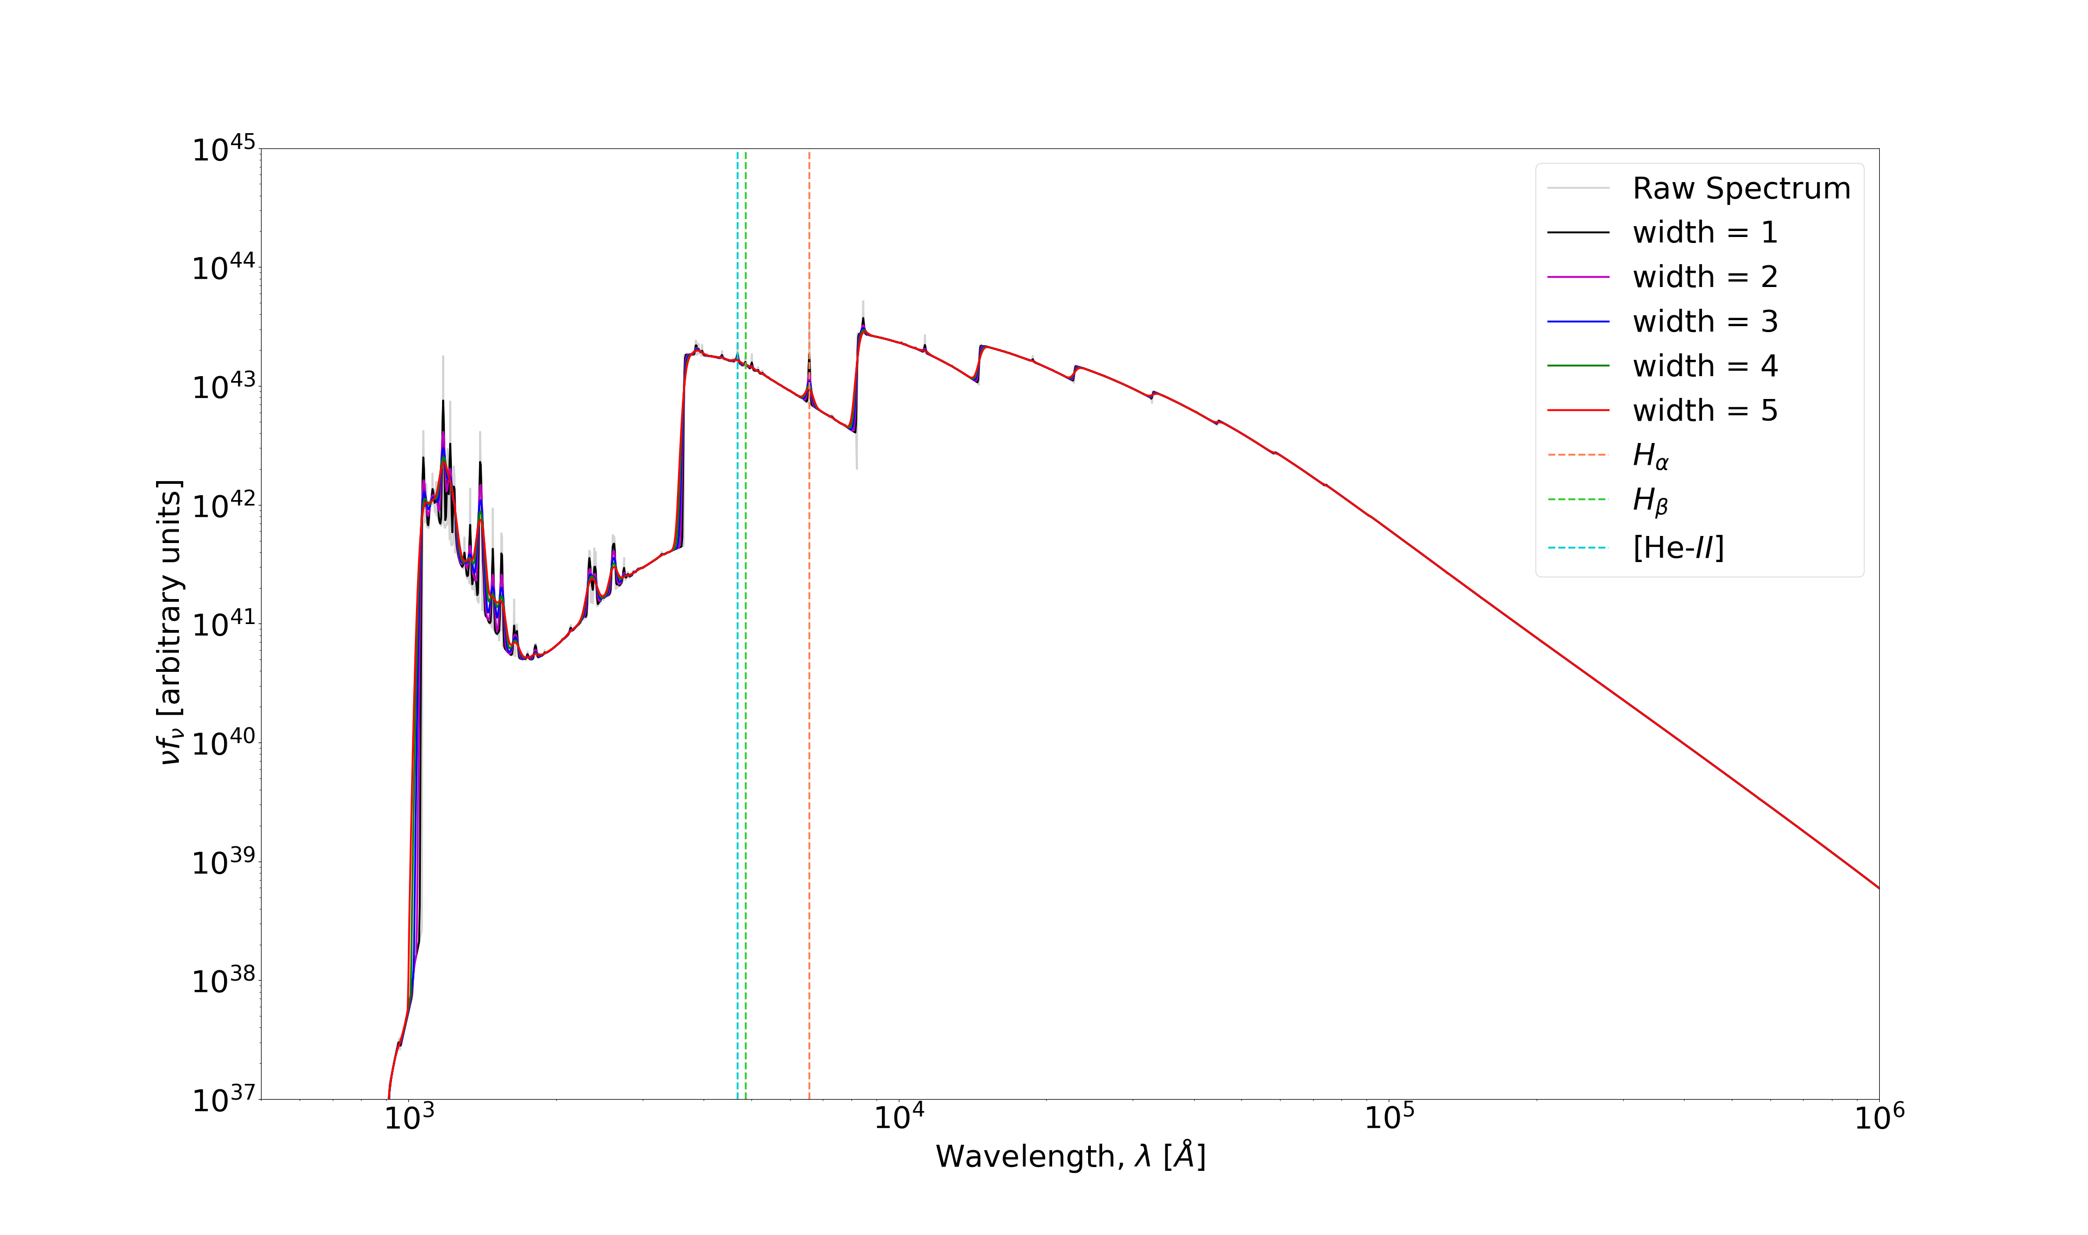

Key points:
Convolved with Gaussian of varying widths - smoothing
Produces visible features normally seen in TDEs
Very visible Lyman and Balmer Edges
Not Observed…
Missing UV continuum?
Not observed…
Uniform Density Envelope - $ρ∼const.$
1.
Lewis Shaw – Spectral Emission from TDE Clouds Around Black Holes

Slide 15
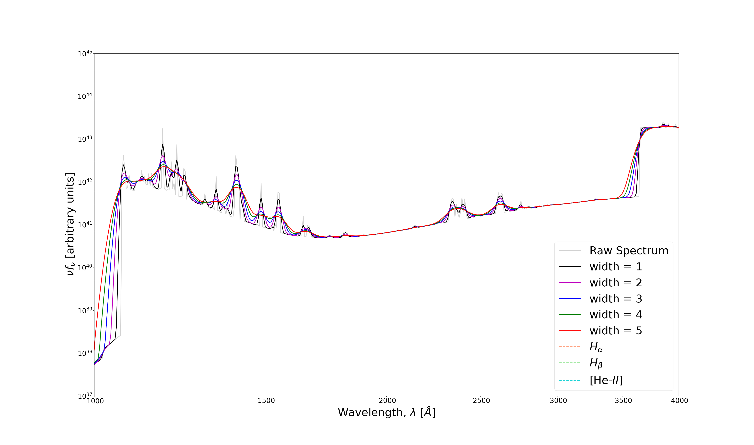
Key points:
Convolved with Gaussian of varying widths - smoothing
Produces visible features normally seen in TDEs
Very visible Lyman and Balmer Edges
Not Observed…
Missing UV continuum?
Not observed…
Ly-α
Balmer Edge
Lyman Edge
Uniform Density Envelope - $ρ∼const.$
1.
Lewis Shaw – Spectral Emission from TDE Clouds Around Black Holes

Slide 16
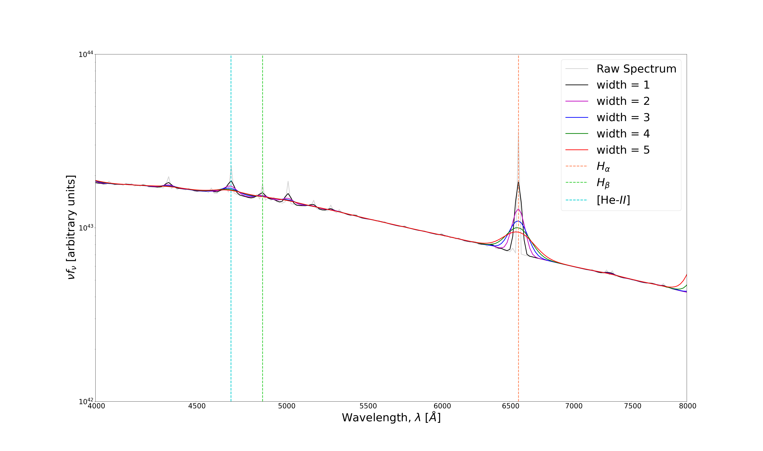
Key points:
Convolved with Gaussian of varying widths - smoothing
Produces visible features normally seen in TDEs
Very visible Lyman and Balmer Edges
Not Observed…
Missing UV continuum?
Not observed…
[He-II]
Hβ
Hα
Uniform Density Envelope - $ρ∼const.$
1.
Lewis Shaw – Spectral Emission from TDE Clouds Around Black Holes

Slide 17
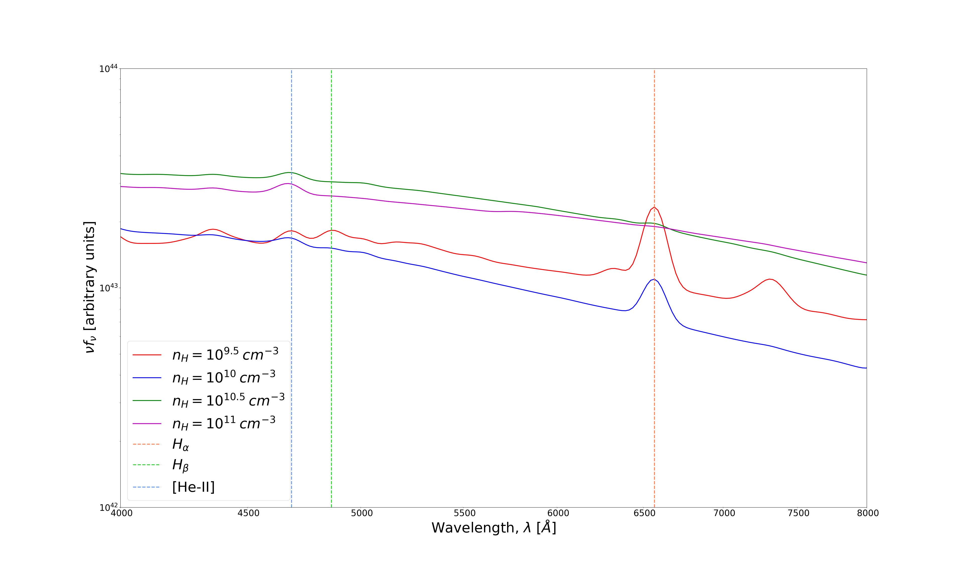
Key points:
As density increases, strength of emission lines w.r.t continuum increases
Avg. intensity of visible increases with increasing intensity
[He-II]
Hβ
Hα
Uniform Density Envelope - $ρ∼const.$
1.
Lewis Shaw – Spectral Emission from TDE Clouds Around Black Holes

Slide 18
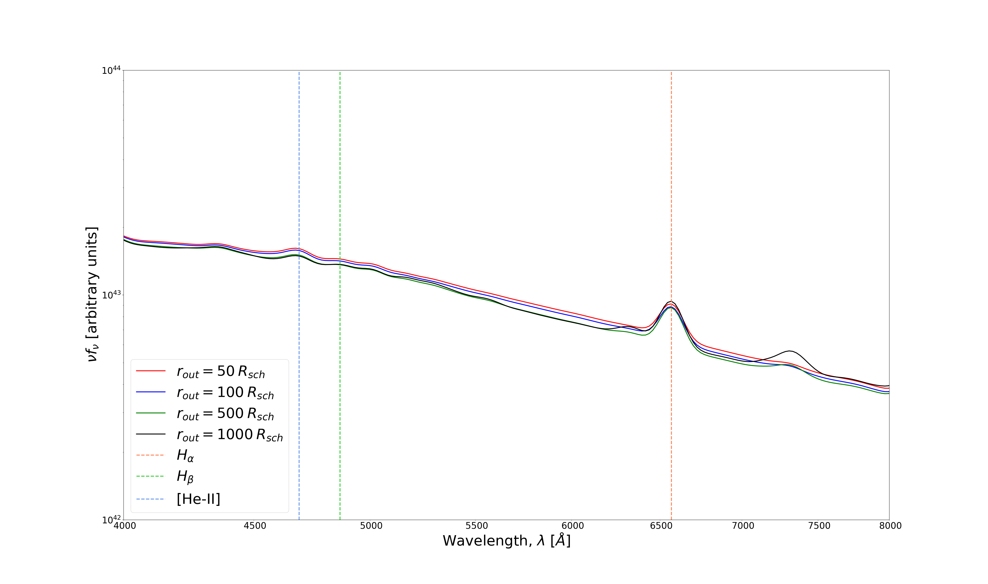
Key points:
As envelope size increases, avg. intensity and strength of lines w.r.t continuum both roughly the same
- Minimal Effect
[He-II]
Hβ
Hα
Uniform Density Envelope - $ρ∼const.$
1.
Lewis Shaw – Spectral Emission from TDE Clouds Around Black Holes

Slide 19
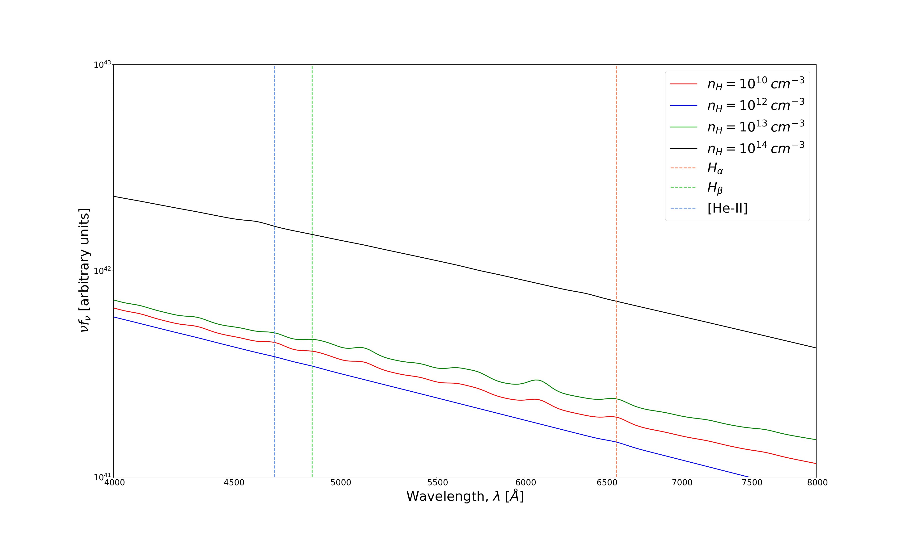

Key points:
Strength of emission lines very low – suppressed
Avg. intensity increases with density
Power Law Density Envelope - $ρ∼r^{−2}$
2.
Lewis Shaw – Spectral Emission from TDE Clouds Around Black Holes

Slide 20
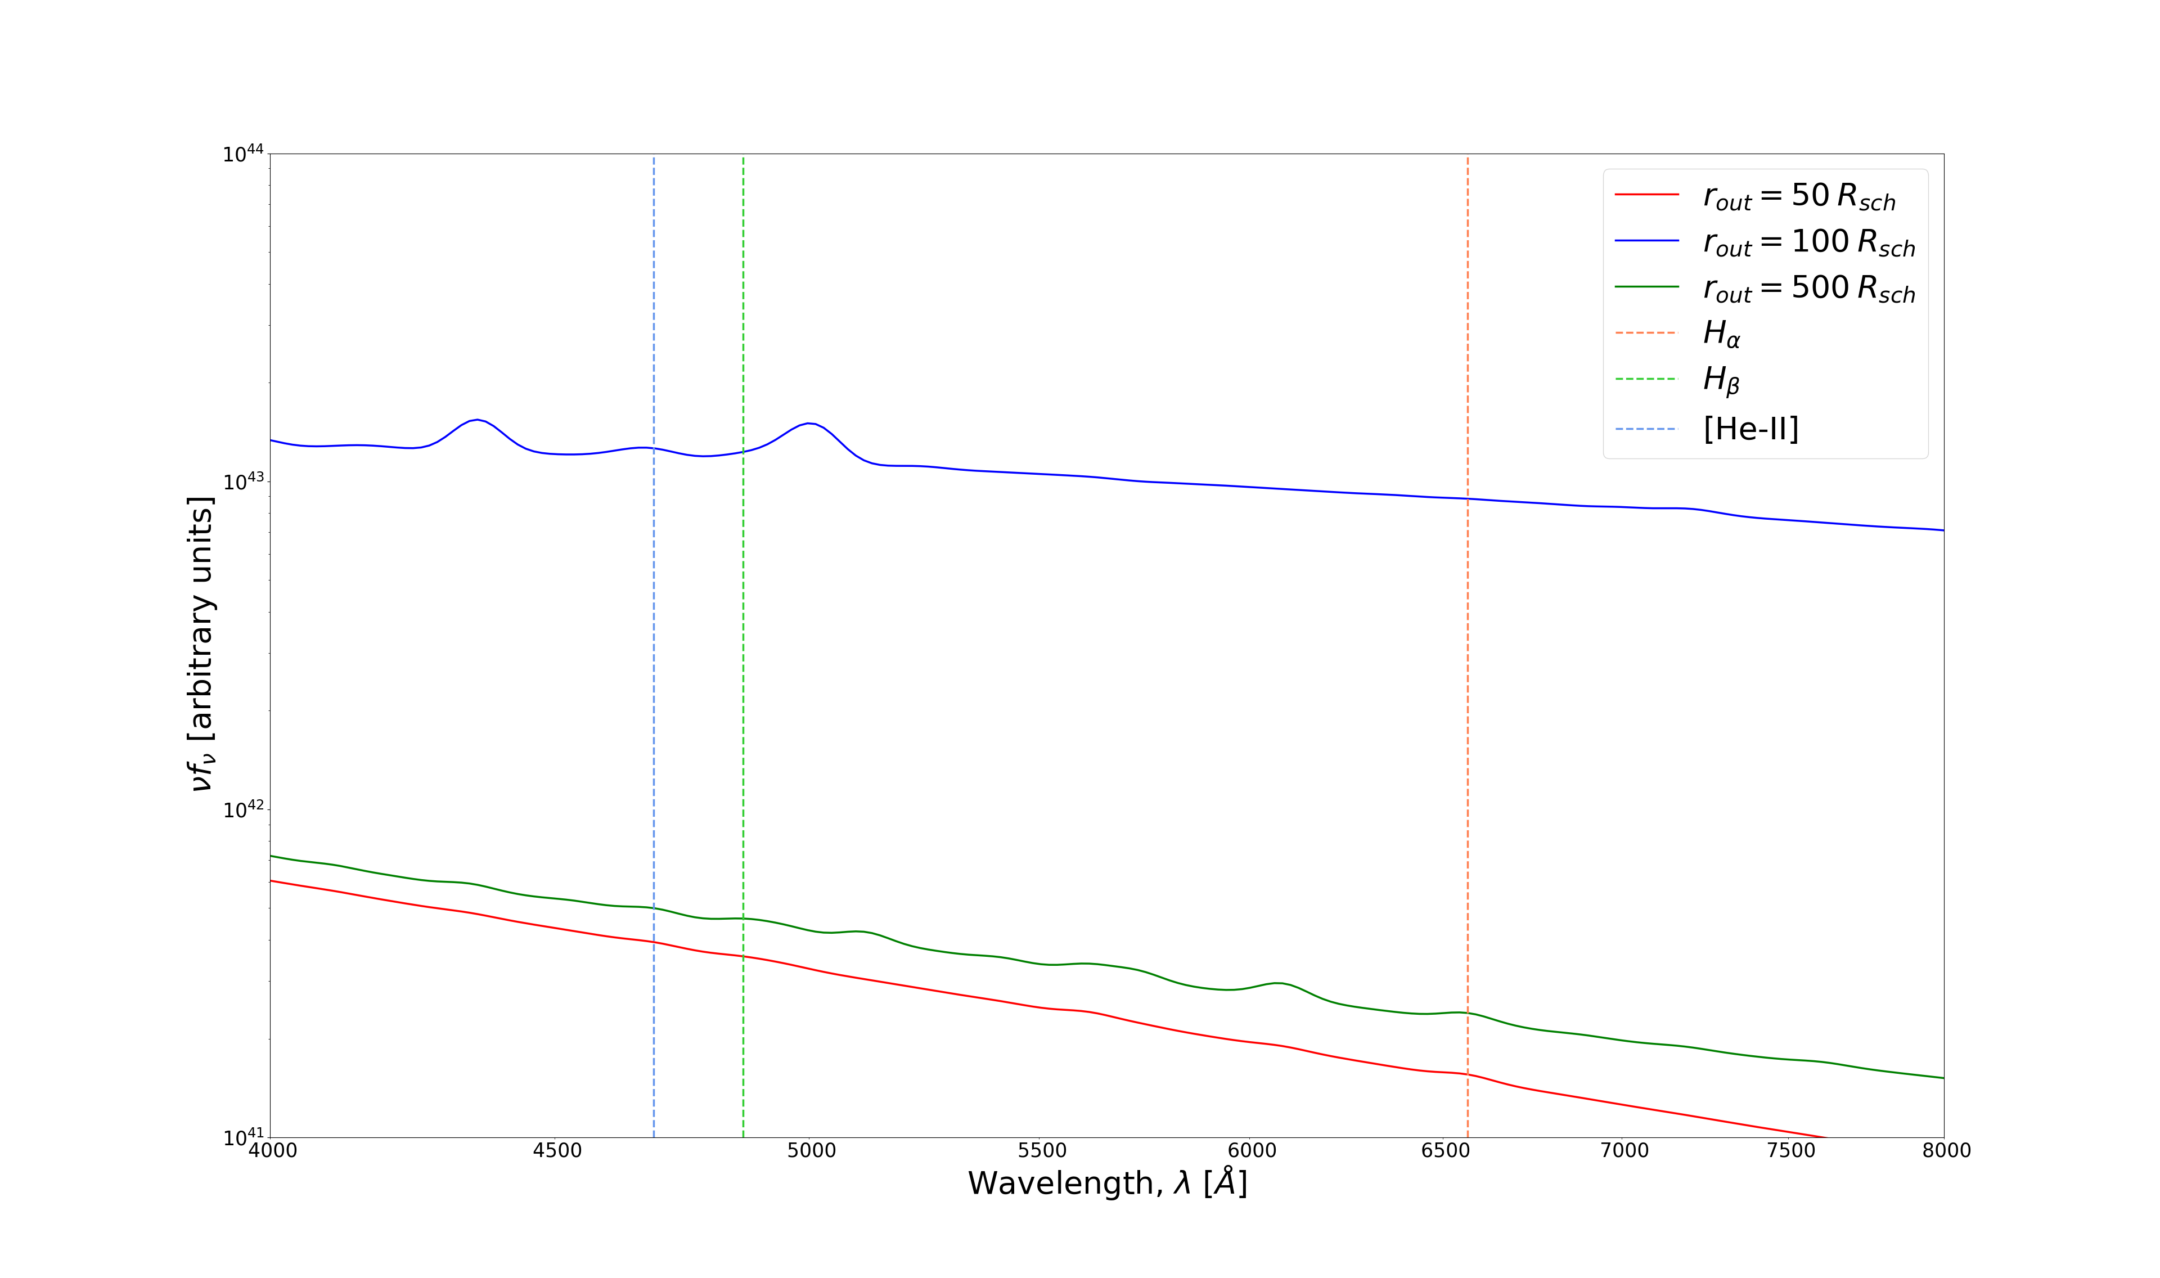
Key points:
Strength of emission lines very low – suppressed
Avg. intensity appears to vary
Power Law Density Envelope - $ρ∼r^{−2}$
2.
Lewis Shaw – Spectral Emission from TDE Clouds Around Black Holes

Slide 21
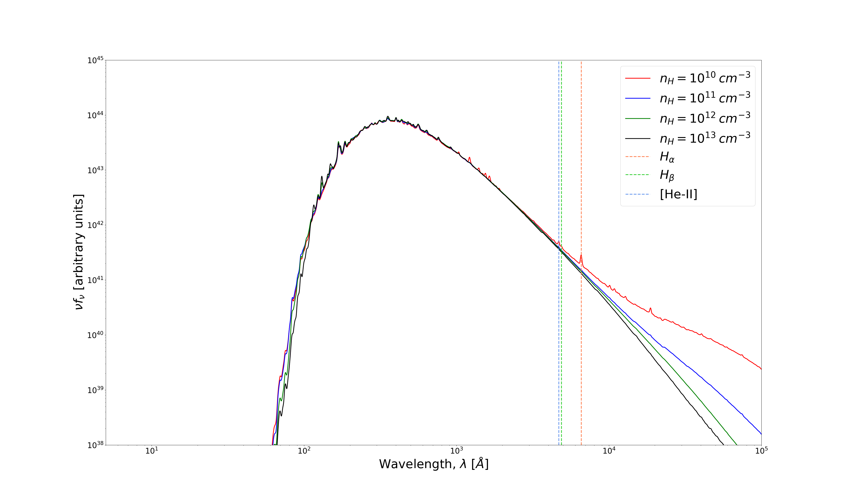
Key points:
Very little effect until NUV/Optical
Avg. intensity decreases with increasing density
Line strengths significantly suppressed with increasing density
Cloud Population
3.
Lewis Shaw – Spectral Emission from TDE Clouds Around Black Holes

Slide 22
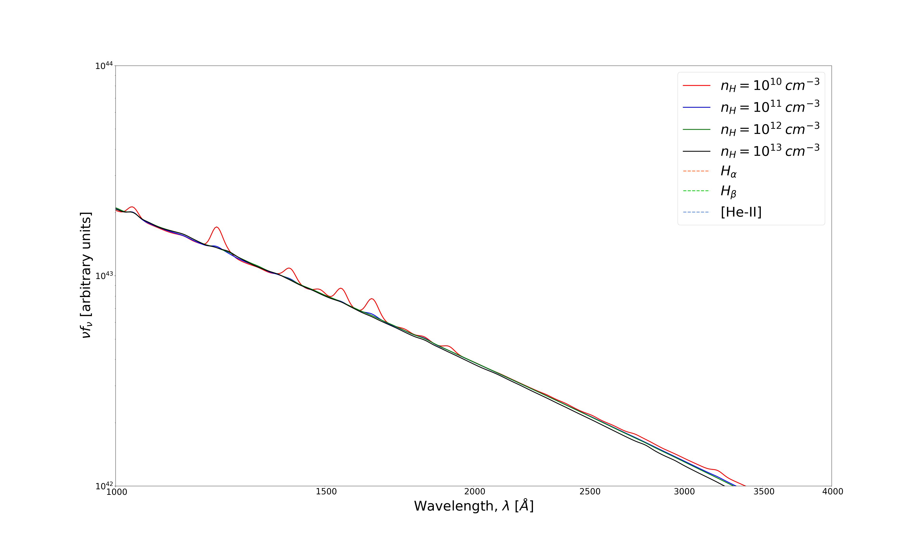
Key points:
Very little effect until NUV/Optical
Avg. intensity decreases with increasing density
Line strengths significantly suppressed with increasing density
Ly-α
Cloud Population
3.
Lewis Shaw – Spectral Emission from TDE Clouds Around Black Holes

Slide 23
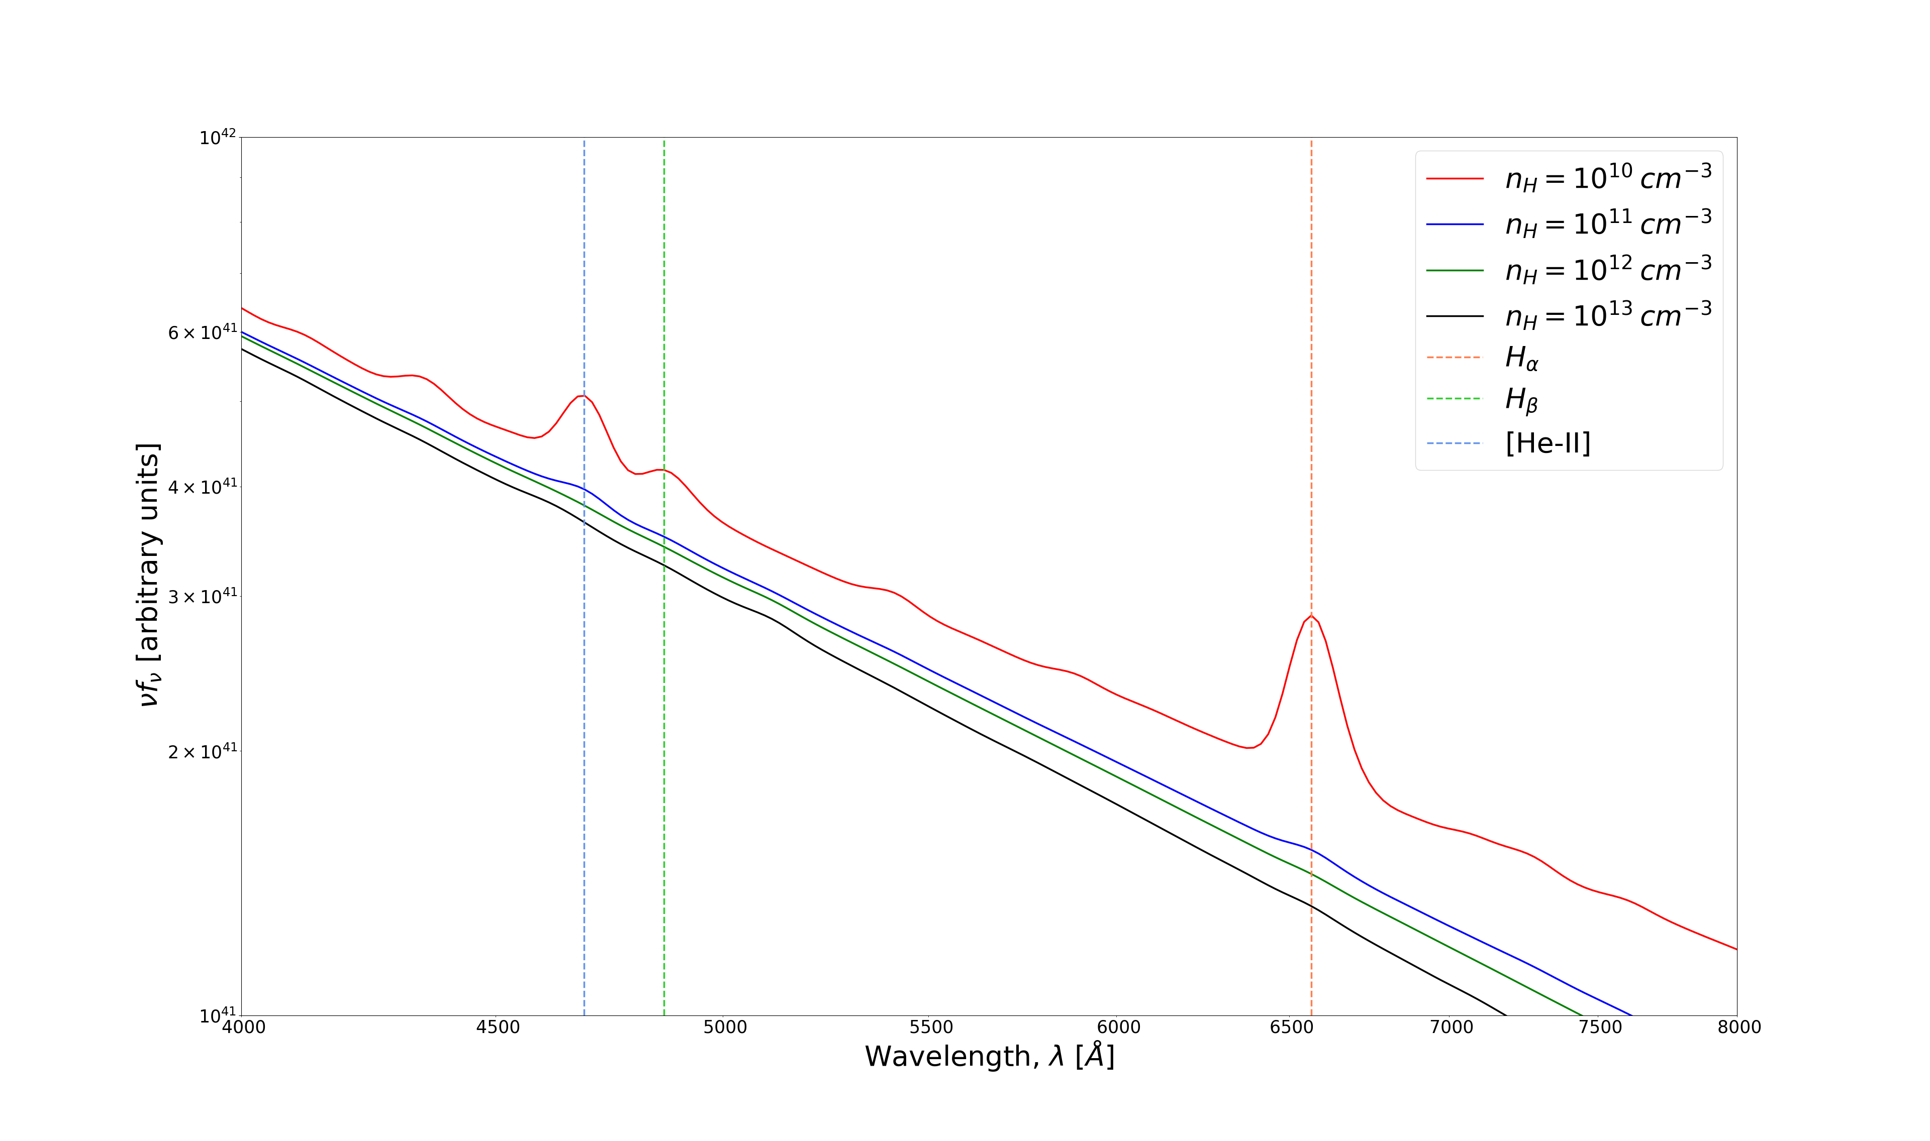
Key points:
Very little effect until NUV/Optical
Avg. intensity decreases with increasing density
Line strengths significantly suppressed with increasing density
[He-II]
Hβ
Ly-α
Hα
Cloud Population
3.
Lewis Shaw – Spectral Emission from TDE Clouds Around Black Holes

Slide 24
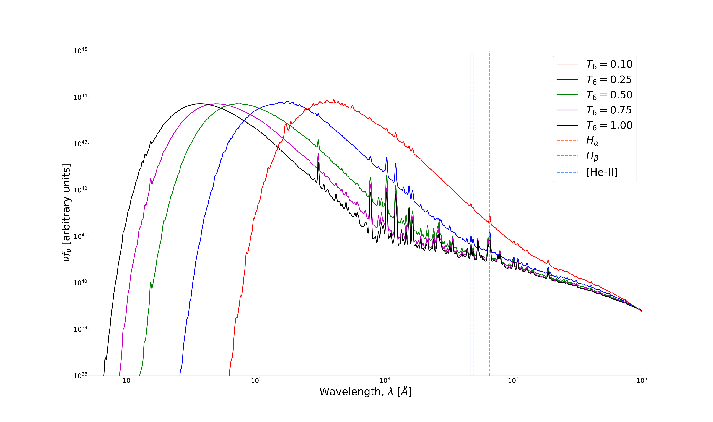
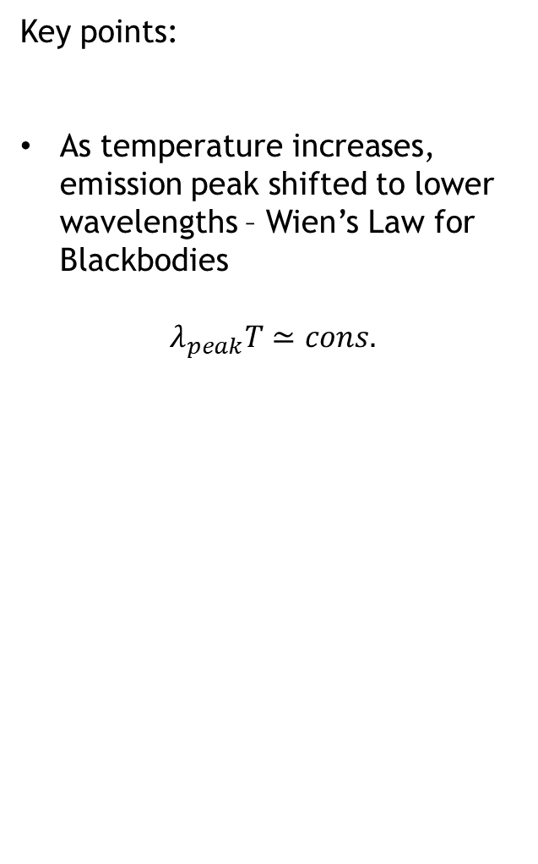
Key points:
As temperature increases, emission peak shifted to lower wavelengths – Wien’s Law for Blackbodies
$$λ_{peak}T≃cons.$$
Cloud Population
3.
Lewis Shaw – Spectral Emission from TDE Clouds Around Black Holes

Slide 25
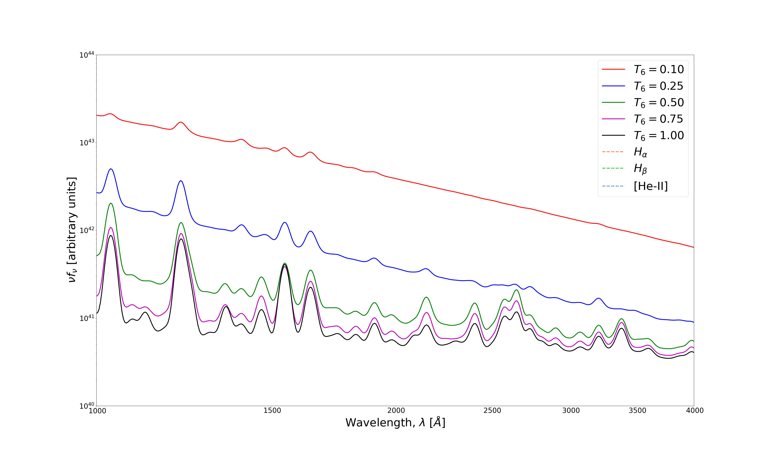
Key points:
As temperature increases, emission peak shifted to lower wavelengths – Wien’s Law for Blackbodies
$$λ_{peak}T≃cons.$$
[He-II]
Hβ
Ly-α
Hα
Ly-α
Cloud Population
3.
Lewis Shaw – Spectral Emission from TDE Clouds Around Black Holes

Slide 26
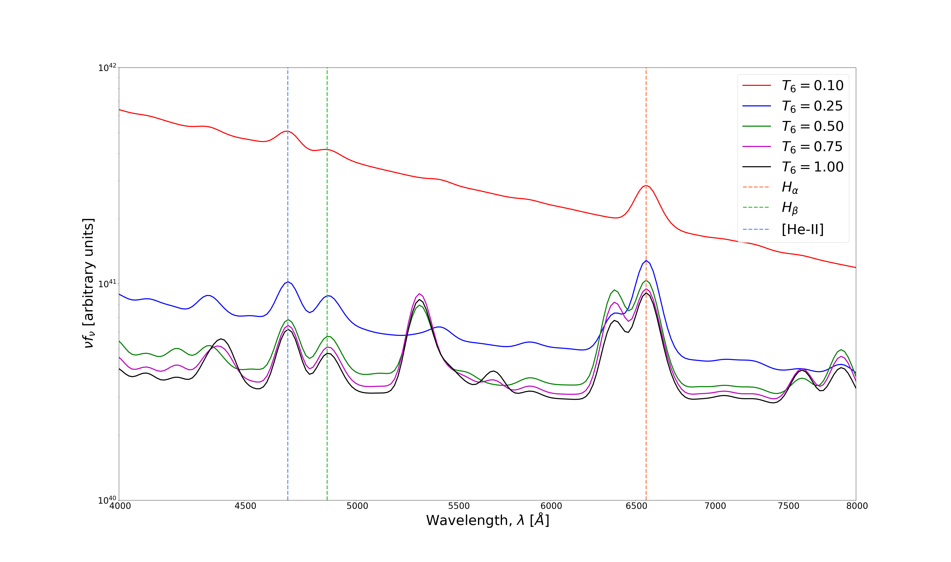
Key points:
As temperature increases, emission peak shifted to lower wavelengths – Wien’s Law for Blackbodies
$$λ_{peak}T≃cons.$$
[He-II]
Hβ
[He-II]
Ly-α
Hα
Hβ
Hα
Cloud Population
3.
Lewis Shaw – Spectral Emission from TDE Clouds Around Black Holes

Slide 27
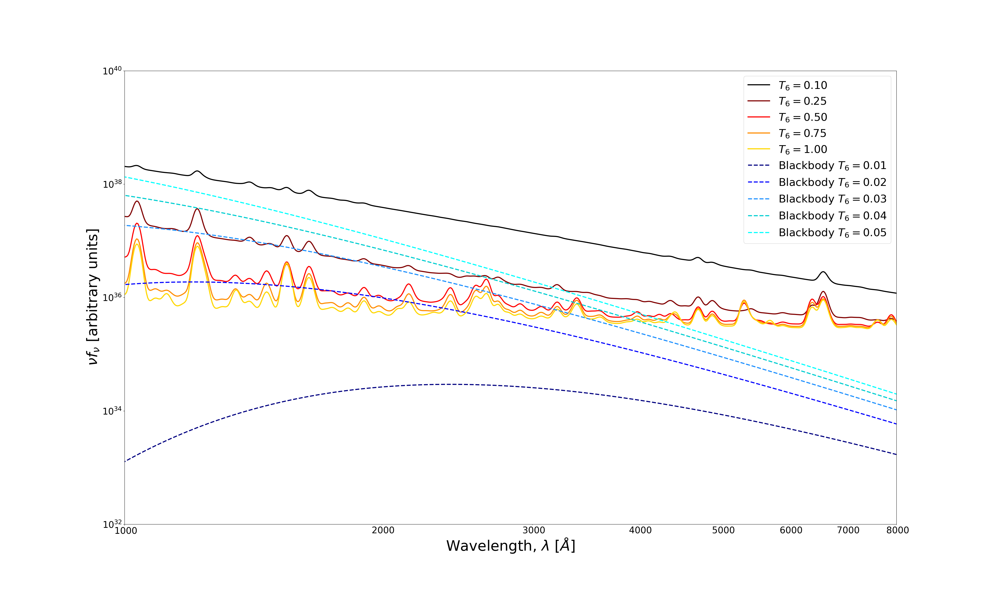
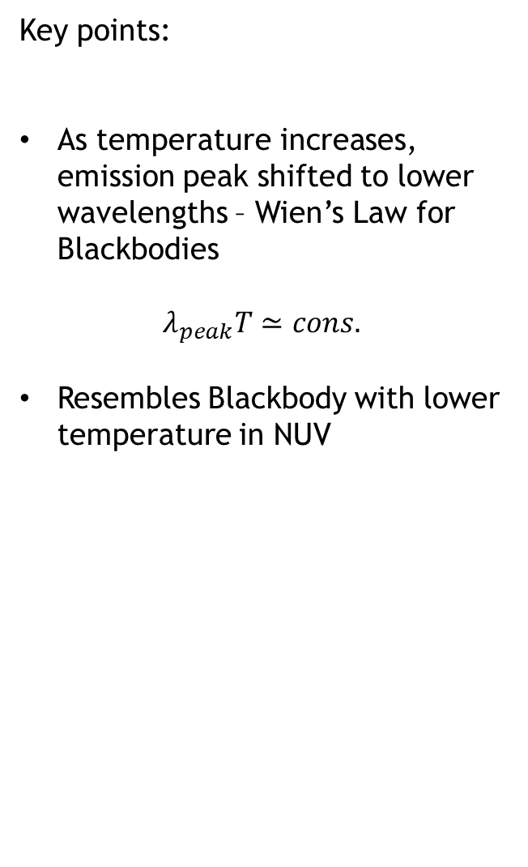
Key points:
As temperature increases, emission peak shifted to lower wavelengths – Wien’s Law for Blackbodies
$$λ_{peak}T≃cons.$$
Resembles Blackbody with lower temperature in NUV
[He-II]
Hβ
[He-II]
Ly-α
Hα
Hβ
Hα
Cloud Population
3.
Lewis Shaw – Spectral Emission from TDE Clouds Around Black Holes

Slide 28

Conclusion
1st Model – Produces visible spectra that is seen in TDEs
Doesn’t produce strong enough UV continuum to explain coronal emission
2nd Model – Doesn’t produce strong enough visible emission
- Maybe something went wrong, should explore this further
3rd Model - Produces visible emission when line of sight meets cloud
- Also produces strong enough ionising continuum when line of sight does not intersect cloud

Slide 29
Next Steps/Future Research
Further investigate 2nd model to see what went wrong
Further tune final model – not necessarily vacuum in between clouds and source

Slide 30
Thanks for Listening!

Slide 31
Appendix

Slide 32
